Slide 1


Understanding customer behavior & revenue trends to drive smarter insurance decisions
Presented By : Parth Patoliya

Slide 2

AGENDA
About Company
Problem Statement
Project Objective
Dataset Overview
Key Terms
Dashboard View
Insights
Recommendations

Slide 3
ABOUT COMPANY
Shield Insurance provides affordable & customizable insurance solutions tailored to individuals across all age groups.
With a presence in Mumbai, Chennai, Delhi, Hyderabad, Indore.
The company operates through offline agents, direct sales teams, a mobile app, and a website.

Slide 4

PROBLEM STATEMENT
Shield Insurance currently lacks a consolidated & interactive view to effectively monitor customer growth, revenue performance, policy trends.
Additionally, there is limited visibility into how customer behavior varies across age groups, cities, sales modes, and policies.
This makes it difficult for stakeholders to identify growth trends, evaluate sales channel performance & understand demographic impacts on revenue and settlement expectations.

Slide 5
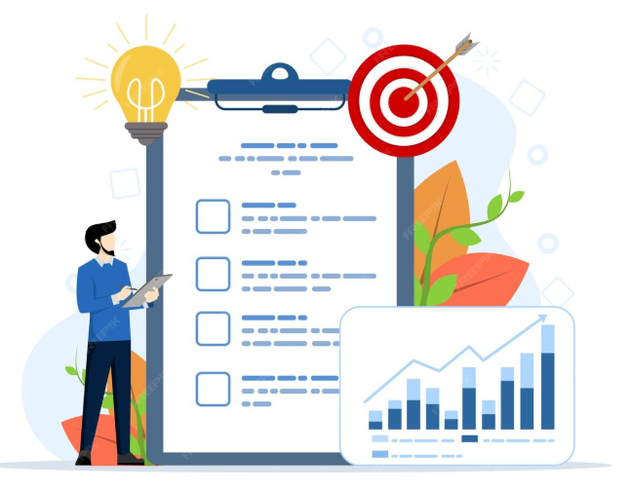
PROJECT OBJECTIVE
Track total customers & total revenue
Monitor daily & month-over-month growth trends
Analyze performance across cities, sales modes, policies, age groups
Identify high-value customer segments & effective sales channels
Understand age-group-wise revenue contribution & expected settlement exposure

Slide 6
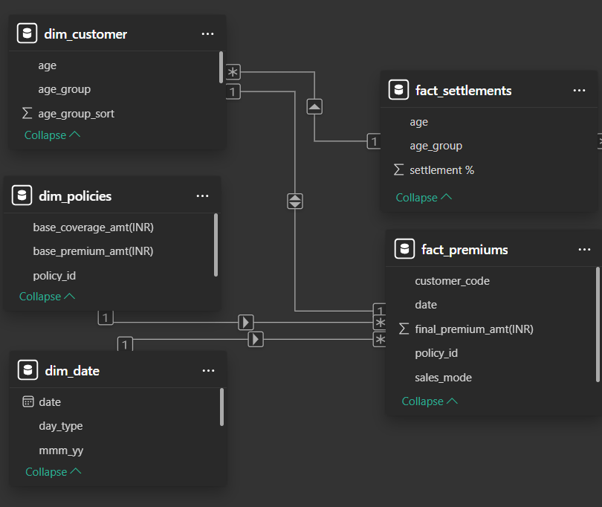
Dataset Overview

Slide 7

KEY TERMS

Slide 8

Base Coverage Amount(The Piggy Bank Size)
It is the maximum money the insurance company promises to help you with.
Means how big your piggy bank is or piggy bank can give me money up to this limit.
Example:
Piggy bank size = ₹5,00,000

Slide 9

Premium (Money You Put in the Piggy Bank)
This is the small amount you pay regularly to keep the piggy bank active.
I pay a little money so the piggy bank will help me later.
Example:
You pay ₹1,000 every month or ₹10,000 a year

Slide 10


Claim(Something Bad Happens & asking for help)
You ask the piggy bank for help.
When You fall sick, meet with an accident, or something breaks.
Example:
You ask for ₹3,00,000

Slide 11
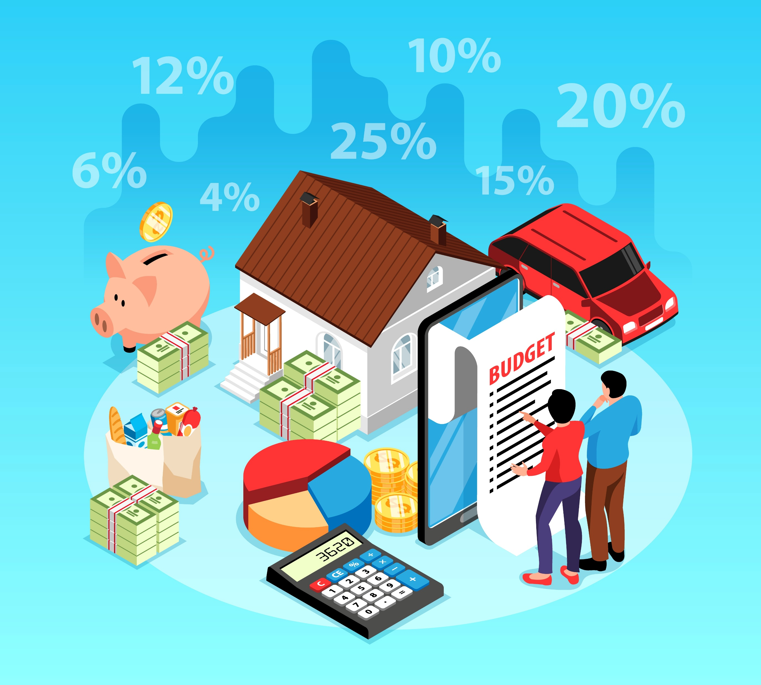
Settlement Amount (Money You Get)
The insurance company checks the rules and then gives you money.
This is the money the piggy bank actually gives me.
Example:
They give ₹2,40,000
Settlement Percentage (How Much Help You Got)
Higher settlement% = reliable policyholder
Example:
Asked for: ₹100
Got: ₹80
Settlement % = 80%

Slide 12

INSIGHTS

Slide 13
City Level Insights
Delhi NCR: Highest revenue ₹401.57M | Highest customers 11,007
Indore: Lowest revenue ₹81.35M | Lowest customers 2,096
Delhi & Mumbai: Only cities with 1,000+ customers across all sales modes
Indore: Weak customers presence (250–350) except Offline Agent (1,176)
March: Peak month — Revenue ₹ 264M, Customers 7,081
November: Weakest month — Revenue ₹132M, Customers 3,787

Slide 14
Age Group Insights
31–40: Highest revenue ₹ 309.32M | Highest customers 10,431
50+: Strong 11,400 customer base | Highest settlement % (65+ → 74.33%)
Under 30 (18–24 & 25–30): Lowest revenue (₹24.94M, ₹56.73M)
Settlement % increases with age, huge increase after 50+
POL2005HEL: Top revenue generator across all age groups
Policy preference by age groups based on total customers :
- 18–30 → POL4321HEL
- 31–40 → POL3309HEL
- 41–50 → POL5319HEL
- 51–65 → POL9221HEL
- 65+ → POL2005HEL

Slide 15
Sales Mode & Policy Insights
Offline Agent : Dominates Customers 14,873 (55.41%) | Revenue ₹551M (55.67%)
Online Website : Weakest Customers 3,410 (12.7%) | Revenue ₹125M (12.6%)
Policy Performance:
- POL2005HEL : Highest revenue ₹324M, low customers 1,968
- POL4321HEL : Highest customers 4,434, lowest revenue ₹25M
Only 4 policies cross >100M revenue : POL2005HEL, POL1048HEL, POL6303HEL, POL9221HEL

Slide 16

Recommendations
Prioritize core segments (31–40 & 50+) to maximize revenue, retention & settlement trust.
Fix underperforming segments (Under-30 & Tier-2 cities like Indore) to unlock untapped growth.
Strengthen Offline Agent dominance while urgently upgrading the Online Website to improve digital adoption.
Rebalance product portfolio by expanding POL2005HEL reach & improving POL4321HEL revenue quality.
Replicate Delhi NCR’s successful sales model across other high-potential or underperforming cities.
Use March success patterns and introduce promotional campaigns to uplift weak months like November.

Slide 17


